Slide 1
Collaboration-Based Design
Prof. Dr. Dirk Riehle
Friedrich-Alexander University Erlangen-Nürnberg
ADAP C10
Licensed under CC BY 4.0 International
Notes:
It is Friedrich-Alexander University Erlangen-Nürnberg – FAU, in short.
Corporate identity wants us to say “Friedrich-Alexander University”.

Slide 2
Agenda
Collaboration-based design
File system example revisited
Collaborations vs. classes
Flower collaborations
Collaborations in UML
Implementing collaborations
Collaborations and design patterns

Slide 3
1. Collaboration-Based Design

Slide 4
Collaboration-based Design
Collaboration-based design
  An approach to modeling and implementation using collaborations
Collaboration (specification / description) a.k.a. role model
  A model of objects collaborating for one particular purpose
Role (type / specification / description)
  A model of the behavior of one object within a collaboration
Collaboration (instance)
  A set of specific objects collaborating according to a collaboration specification
Object
  The representation of a phenomenon playing roles in collaborations

Slide 5
Benefits of Collaboration-based Design
Separation of Concerns
Better Reusable Models

Slide 6
Types of Collaborations
Primary service collaborations
  Typically, client-service-collaborations
  The client role often has no methods
  Visible to the outside (of the model)
Secondary service collaborations
  Client-service-collaborations used for technical purposes
  Often follow design patterns to realize logic
  Visible to the outside (of the model)
Maintenance collaborations
  Collaborations that maintain the domain logic within the model
  Often follow design patterns to realize logic
  Usually not visible to the outside

Slide 7
2. File System Example Revisited

Slide 8
File System Example Revisited

Slide 9
Primary Service Collaborations

Slide 10
Primary Service Roles as Code
public class Node {
// Client-Node-Collaboration
public String getName();
public void setName(String name);
...
}
public class Link extends Node {
// Client-Link-Collaboration
public Node getTarget();
...
}
public class File extends Node {
// Client-File-Collaboration
public void write(byte[] data);
...
}

Slide 11
Hierarchy Collaboration

Slide 12
Secondary Service Roles as Code
public class Node {
// Hierarchy-Collaboration
public Node getOwner();
public void setOwner(Node n);
// Other collaborations
...
}
public class Directory extends Node {
// Hierarchy-Collaboration
public void addOwned(Node n);
public void removeOwned(Node n);
public Iterater getIterator();
// Other collaborations
...
}

Slide 13
Parent Child Collaboration

Slide 14
Maintenance Roles as Code
public class Node {
// Parent-Child-Collaboration
protected Node getParent();
protected void setParent(Node n);
// Other collaborations
...
}
public class Directory extends Node {
// Parent-Child-Collaboration
// No methods
// Other collaborations
...
}

Slide 15
3. Collaborations vs. Classes

Slide 16
Collaboration / Class Duality
A collaboration focuses on
  The interaction of objects for one purpose
A class focuses on
  The integration the roles an object plays in multiple collaborations

Slide 17
Collaborations and Role Binding to Classes

Slide 18
Collaboration-based Design and Reuse
For a collaboration to be used in multiple contexts
  It needs to be independent of those contexts
    Naming cannot be context-specific → Node becomes Owned
  It must be possible to apply it to those contexts
    Naming should be adjustable (method renaming) → Owned becomes Node
  Role composition (in one class) needs to be made explicit
    Composition has important domain analysis meaning
Reusable models need programming language support
Collaboration-based design and design by contract work together well

Slide 19
Levels of Abstraction
 | Design Pattern | Design Template | Class Model
Level | Design illustration | Design template | Specific model
Language | No formal language available | UML-Collaboration | UML-Class-Model, UML-Collaboration-Use
Use in CBD | N/A | Collaboration | Role binding
Example | N/A | Hierarchy = { Client, Owner, Owned } ParentChild = { Parent, Child } | Hierarchy.Owner → Directory ParentChild.Parent → Directory

Slide 20
4. Flower Collaborations

Slide 21
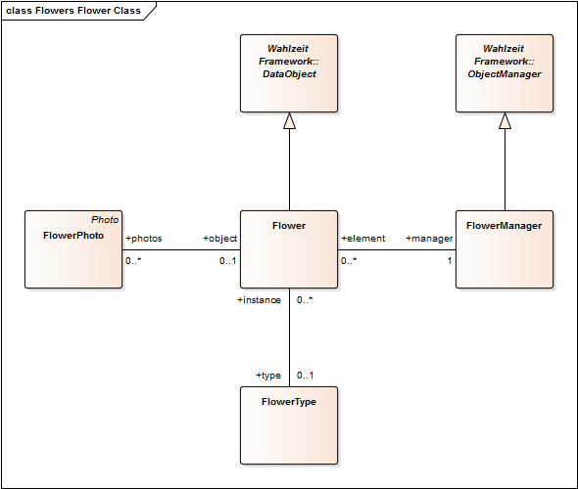

Slide 22
ObjectManager / Persistent collaboration
Flower / DataObject collaboration
Flower / FlowerType collaboration
FlowerPhoto / Flower collaboration
FlowerManager / Flower collaboration

Slide 23
Flower Collaborations
FlowerPhoto / Flower Collaboration
  Purpose: Provide main domain functionality
  Role types: FlowerPhoto (Client), Flower (Service)
Flower / FlowerType Collaboration (Type Object)
  Purpose: Provide information common to all instances of a type
  Role types: Client, Flower (Base Object), FlowerType (Type Object)
FlowerManager / Flower Collaboration (Manager)
  Purpose: Centralize object management in one place
  Role types: Client, FlowerManager (Manager), Flower (Element)

Slide 24
Lessons from the Flower Collaborations
Collaborations
  Often have an implicit Client role
  Almost always overlap when applied to a class model
  There can be inheritance between collaborations
  Many collaborations are design pattern applications

Slide 25
5. Collaborations in UML

Slide 26
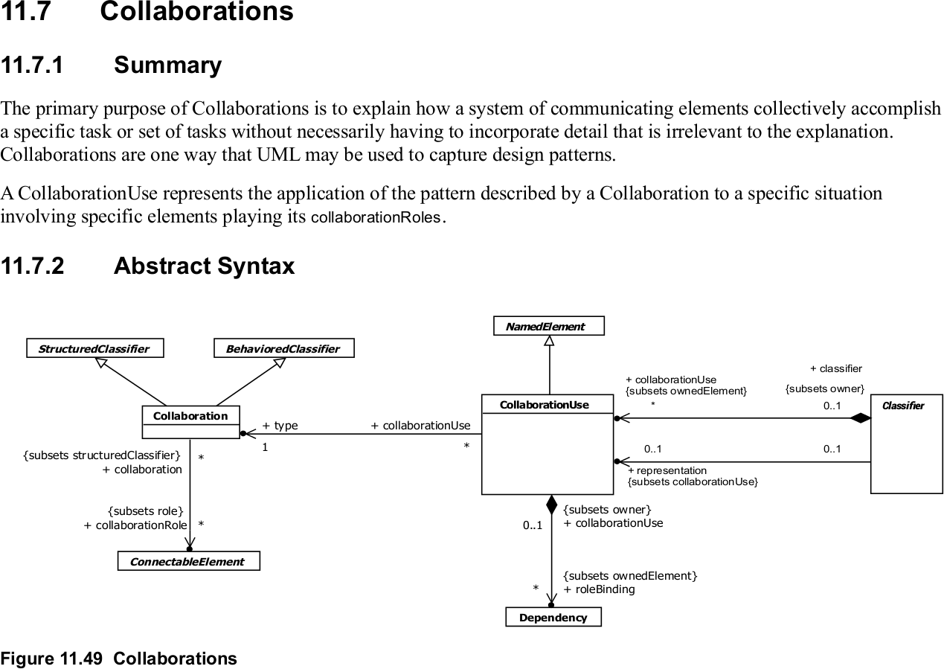
UML and Collaboration-based Design [1]
[1] From the UML 2.5 specification (May 2011)

Slide 27
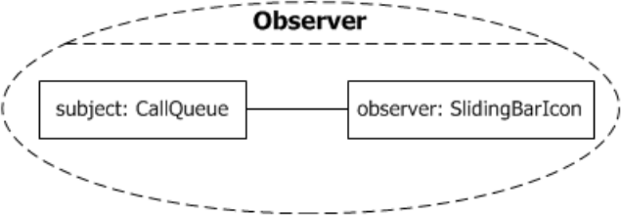
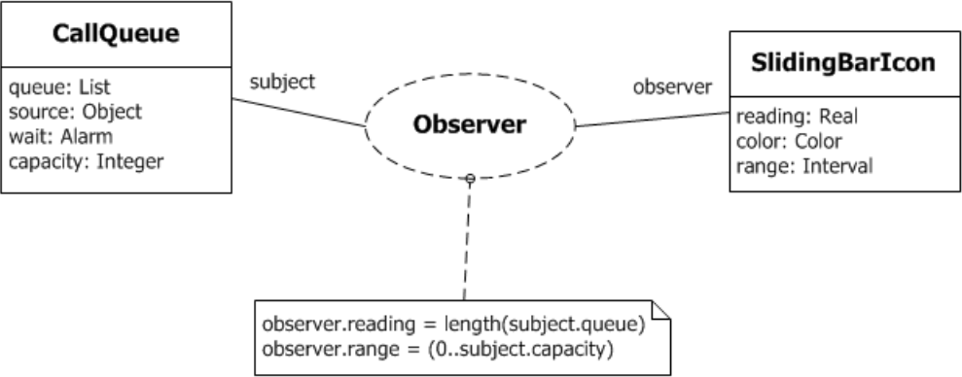
Concrete Syntax for Collaborations

Slide 28
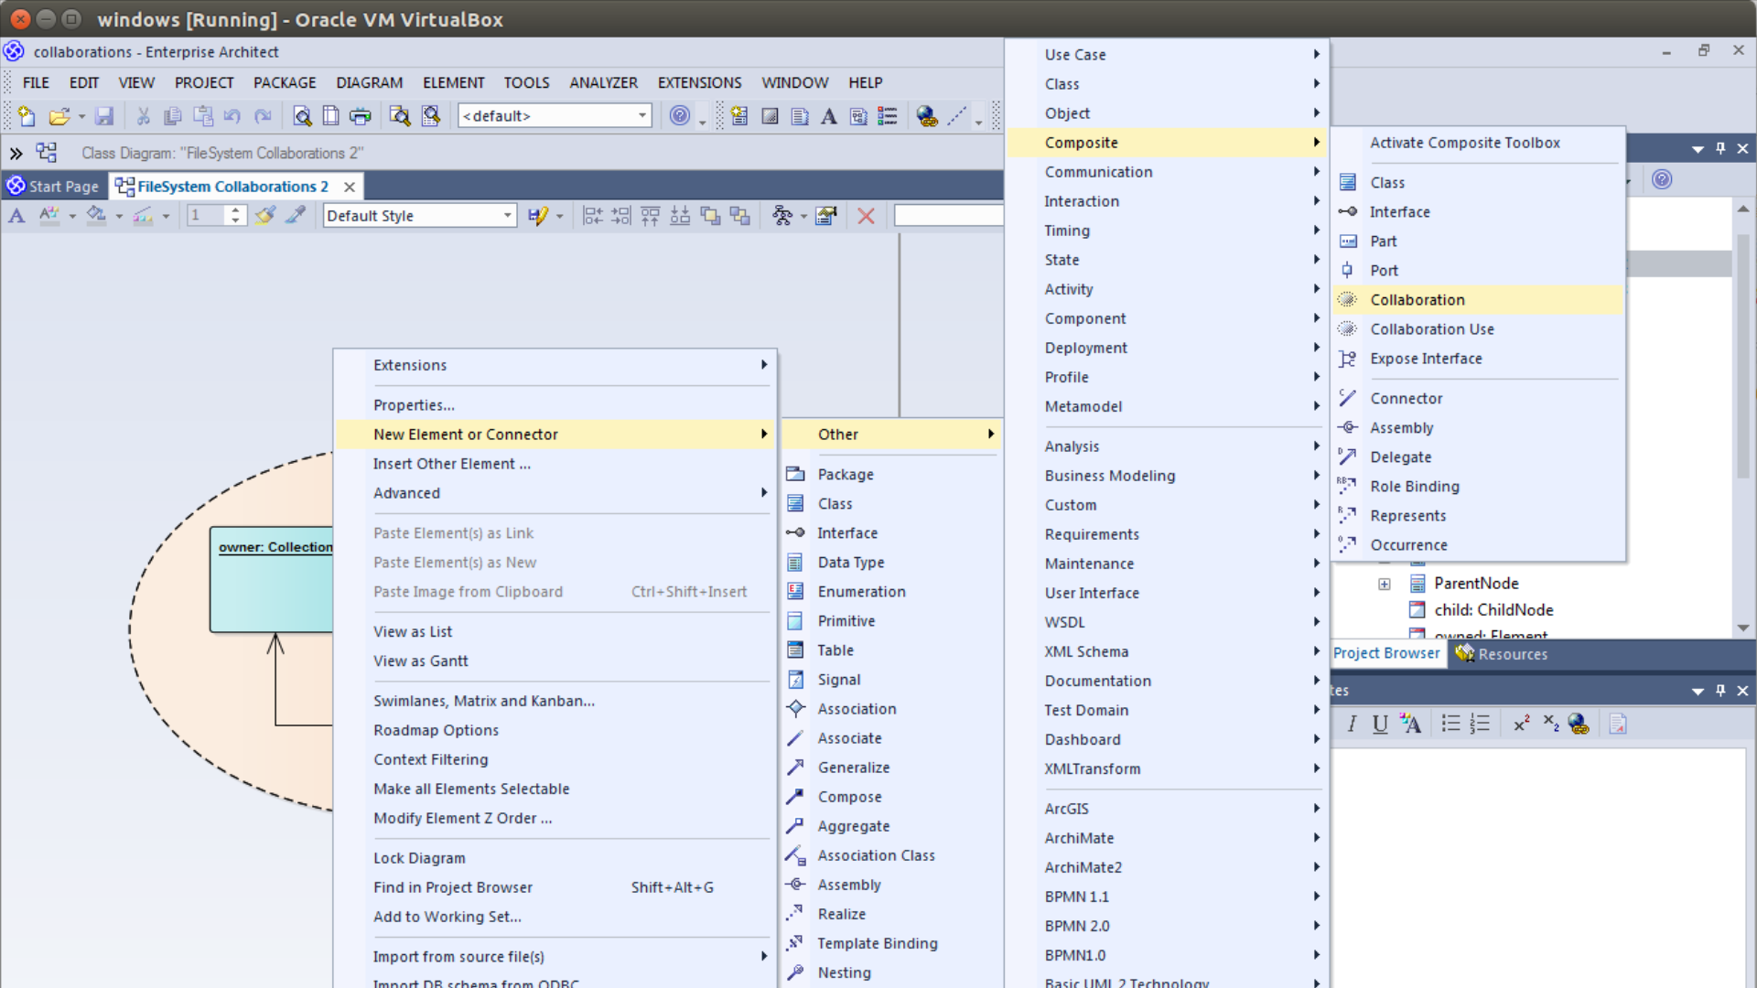

Slide 29
6. Implementing Collaborations

Slide 30
Collaborations in Programming [R00]
public collaboration ParentChild {
public role Parent {
public void addChild(Child c);
public void removeChild(Child c);
public Iterator<Child> getIterator();
}
public role Child { ... }
...
}
public class Node binds ParentChild.Child {
...
}
public class Directory extends Node binds ParentChild.Parent {
...
}

Slide 31
Roles as Code Templates [V97]
public interface Owner<C> {
public void addOwned(C c);
public void removeOwned(C c);
public Iterator<C> getIterator();
}
public class Node {
protected Node parent = null;
protected Node getParent() { ... }
protected void setParent(Node n) { ... }
...
}
public class Directory extends Node, implements Owner<Node> {
public void addOwned(Node n);
public void removeOwned(Node n);
public Iterator<Node> getIterator();
...
}

Slide 32
Client-side Role Specifications
public collaboration File {
public role Client {
// no methods, but specification of
// behavioral constraints, e.g.
// no read or write before open or after close
}
public role File {
public void open();
public byte[] read(int);
public void write(byte[]);
public void close();
...
}
}

Slide 33
Similar / Related to Roles
Interfaces
Protocols
Mix-ins
Traits

Slide 34
7. Collaborations and Design Patterns

Slide 35

Composite Pattern Revisited [G+95]

Slide 36
Participants Section of Composite Pattern
Component (Graphic)
  Declares the interface for objects in the composition
  Implements default behavior for the interface common to all classes, as appropriate
  Declares an interface for accessing and managing its child components
  (Optional:) Defines an interface for accessing a component's parent in the recursive structure [...]
Leaf (Rectangle, Line, Text, etc.)
  Represents leaf objects in the composition; a leaf has no children
  Defines behavior for primitive objects in the composition
Composite (Picture)
  Defines behavior for components having children
  Stores child components
  Implements child-related operations in the Component interface
Client
  Manipulates objects in the composition through the Component interface

Slide 37
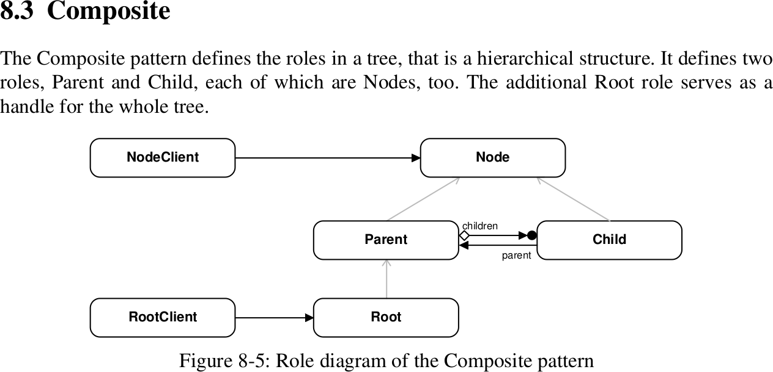
Composite Pattern as Role Model [R97]

Slide 38
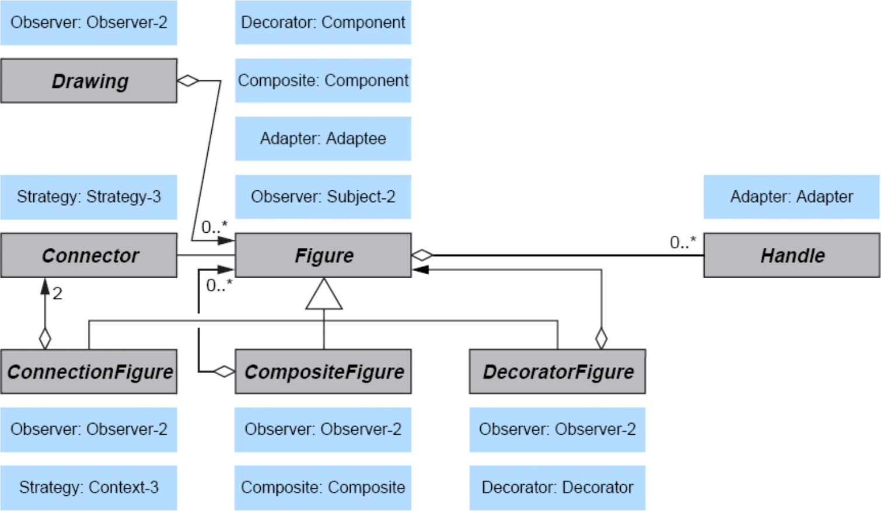
Design Pattern Composition [R11]

Slide 39
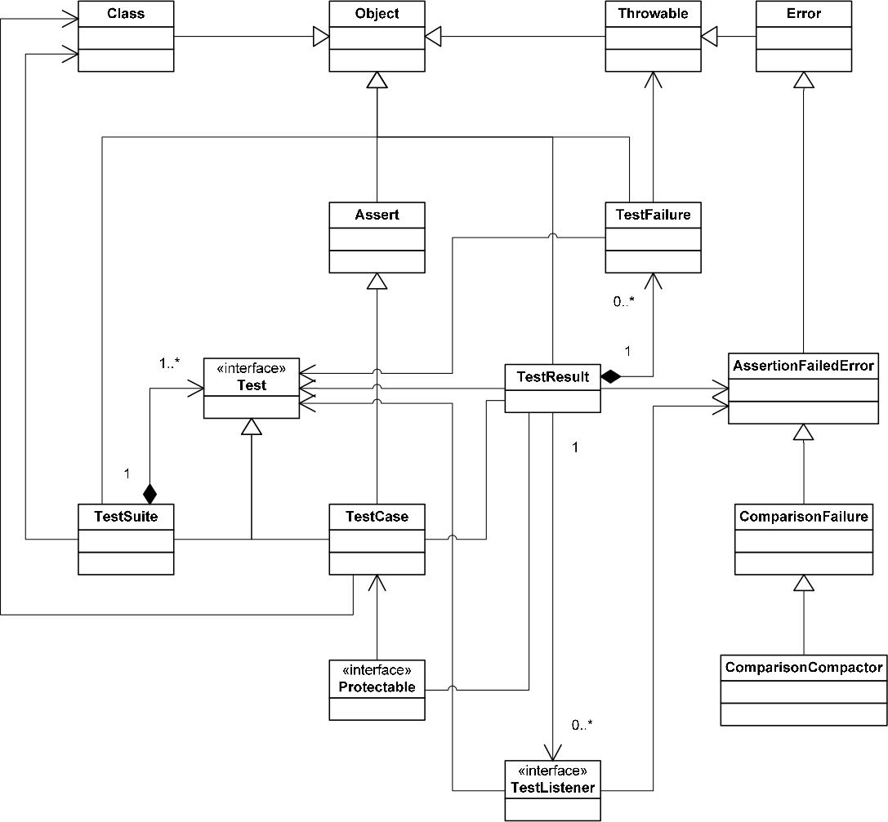

Slide 40
Summary
Collaboration-based design
File system example revisited
Collaborations vs. classes
Flower collaborations
Collaborations in UML
Implementing collaborations
Collaborations and design patterns

Slide 41
Thank you! Questions?
dirk.riehle@fau.de – https://oss.cs.fau.de
dirk@riehle.org – https://dirkriehle.com – @dirkriehle
DR

Slide 42
Legal Notices
License
  Licensed under the CC BY 4.0 International License
Copyright
  © 2012-2022 Dirk Riehle, some rights reserved

